Slide 1
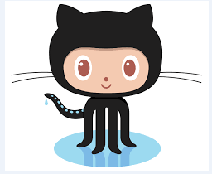
GitHub
Introduction to GitHub
אביב לזר 311514236
דני סימקין 311315022

Slide 2
So what is GitHub?
Basic facts about GitHub:
- Founded in 2008.
- GitHub has seen a major increase in its overall popularity. In 2013 GitHub had 3 million registered users on its site and 5 million user based projects. Today that number stands roughly at 26 million with more than 73 million projects.
- 37% of the Users are female, 63% are male.
Average users’ age is: 35. -
* GitHub is the largest web–based git repository hosting service.
* Allows for code collaboration with anyone online.
* Adds extra functionality on top of git, such as: UI, documentation, bug tracking , feature requests, pull requests, etc…

Slide 3
So what is Git?
Git is a version controlled system
You didn’t hear about VCS? Relax!
Now let’s explain what it means:
* VCS is a method for centrally storing files (more specifically – snapshots).
* Keeping a record of changes: Who did what, where and when in the System.
* Covering yourself when things inevitably go wrong.
* Allows you to revert any changes and go back to a previous state.

Slide 4

Why would we want to use vcs?
As an Individual
- Back-up methodology
- Point in time marking (tagging)
- Branching : release versions maintained while main development can continue.
-Change history: when features were added or amended.
As a Team
- Allow multiple developers (in remote locations) to work on same code base.
- Merge changes across same files: handle collisions
- Answer who did what: blame or praise.

Slide 5
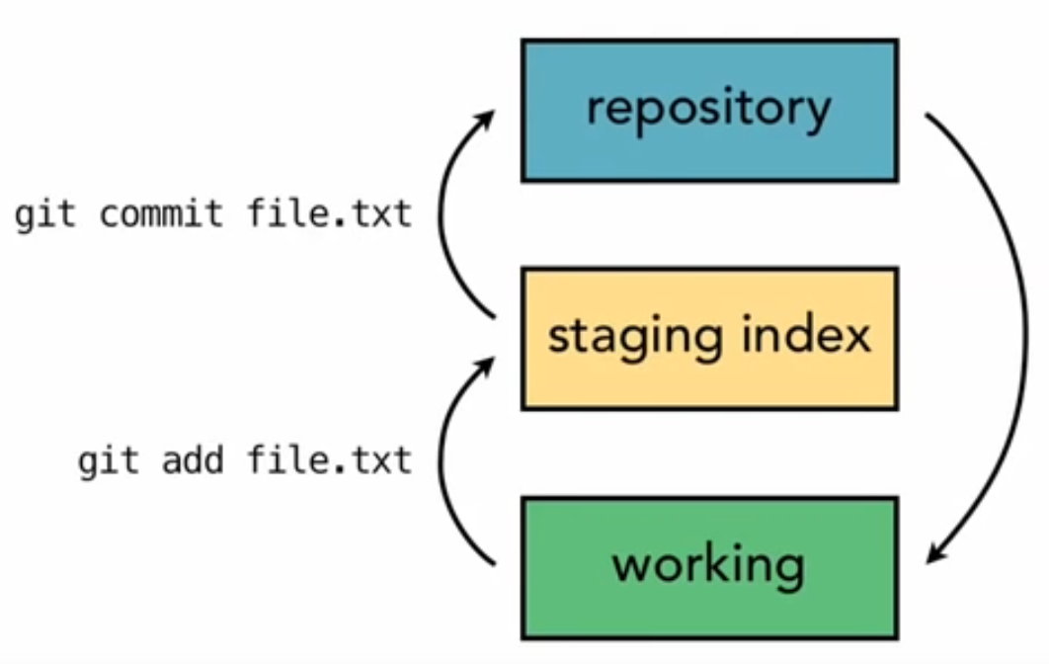
Git was created in 2005 by Linus Torvald to aid in linux kernel development.
Focuses on speed and efficiency. It has relatively simple design and a strong support for thousand of parallel branches. Git is also fully distributed.
How does Git Work?
1) Snapshots:
That is the way git keeps track of your code history. Essentially it records what all your files look at a given point in time. You decide when to take a snapshot and of what files – you have the ability to go back to visit any snapshot.
Your snapshots from later on will stay around too.
Git generally only adds data – so it DOES NOT DELETE.(2
The staging index – when data is added from working stage (3
into the repository we go through a mid stage.
in this stage

Slide 6
How does GitHub help us???
The answer is very simple:
By git-based, we can store our programs (and their changes) individually!
Each person will have their own branch, in which they will not mess other’s work until merge.
We also can “merge” our work to one “branch” easily.
With github, entire team can work on project and focus on creating the code instead of worry about “ what if I screw up someone else’s source code?”.
After syncing your changes, they are moved to the git server.
You still have your own workspace, and work on your changes without worry about others. At the end, simple “merge” will solve combining works together (there is not need to worry about how to combine your code with others since git has this feature already).

Slide 7
What if we don’t use GitHub?
We end up spending more time on managing the work instead of the project in passing files, combining files, etc…
Problem solving will take up much more time than needed.
And probably, yell at each other for whoever screw up the source code.

Slide 8

GitHub Motto: Save Your Time and efforts, for free!

